Slide 1
SAGAR KALAUNI
2024 Analytics & Insight-Intern

Slide 2
Item Count Analysis
Goal: Conduct item count analysis to make items physical count updated.
Ensure continuous availability of critical resources.
A Items – 270 days
B Items – 365 days
C Items – 730 days
What my dashboard should look like?
Main Heading
Slicer
Slicer
Slicer
Item no. | Cur Maximo category | Last physical count date | New physical count date | Remaining Days | Remark | Item Description
123421 | A | 06/30/22 | 06/30/24 | 5 | XXXX | Chain Xxxxx xxxxxx
. . . . | . . . . | . . . . | . . . . | . . . . | . . . . | . . . .
Category | Last week count | Due date next week | Due date next month
A | 32 | 15 | 47
… | … | … | …
Drill through for details
Actual count summary
Notes:
Regular inventory counts-essential to ensure adequate stock levels and prevent shortages during emergencies.

Slide 3
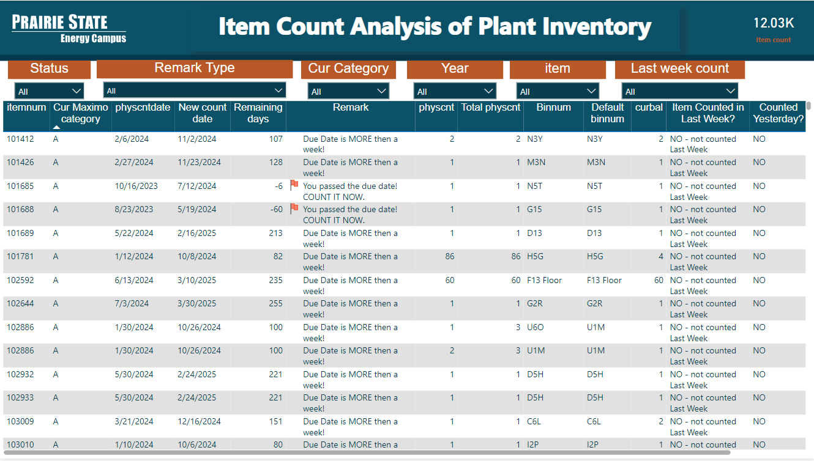
Item count Analysis of Plant Inventory

Slide 4
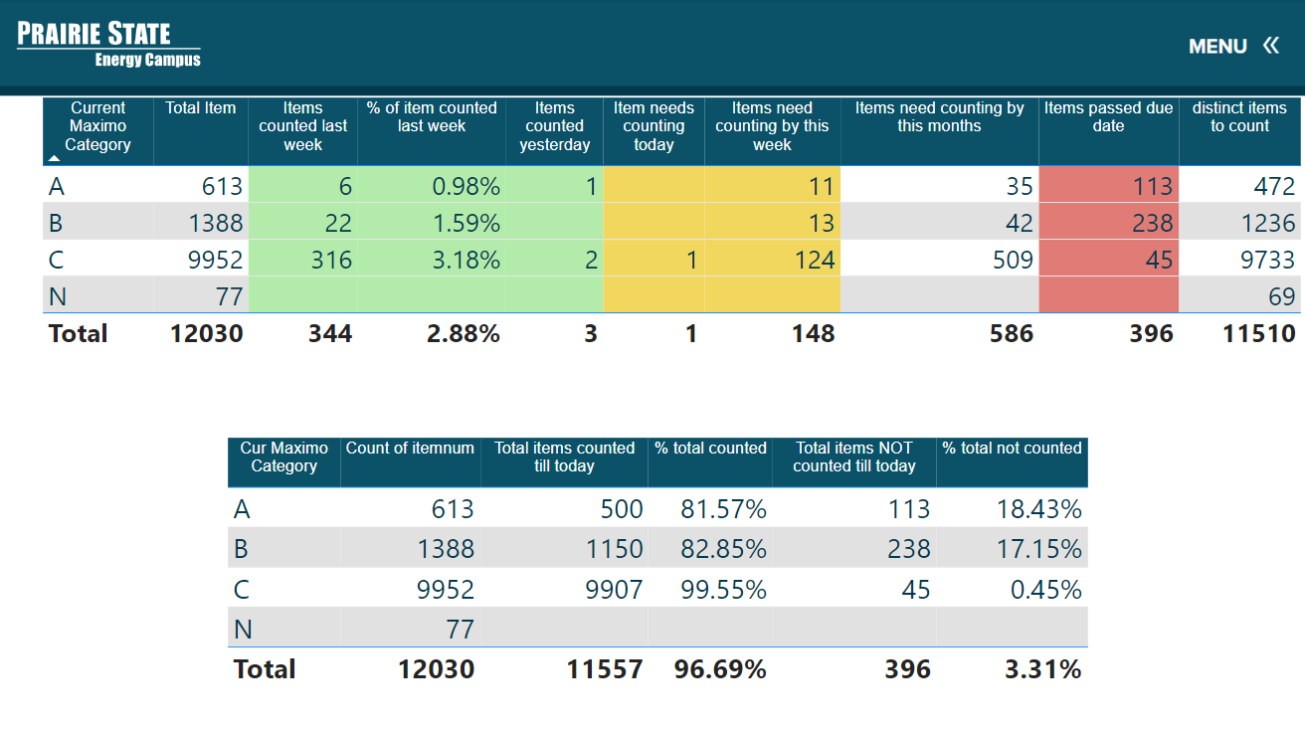
Item count Analysis of Plant Inventory
Summary Tab

Slide 5
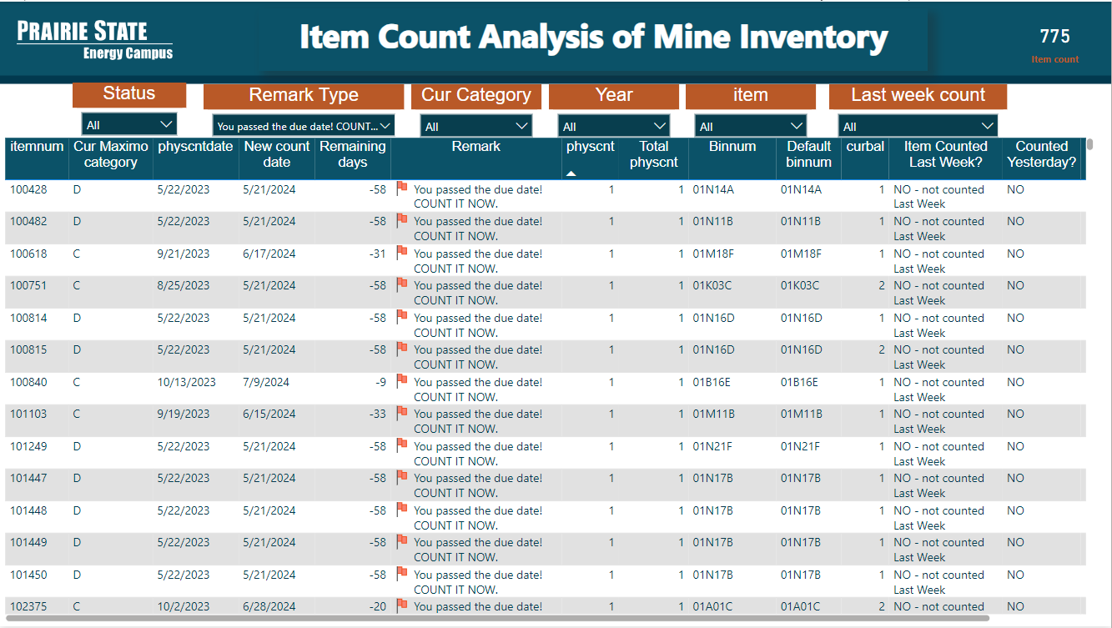
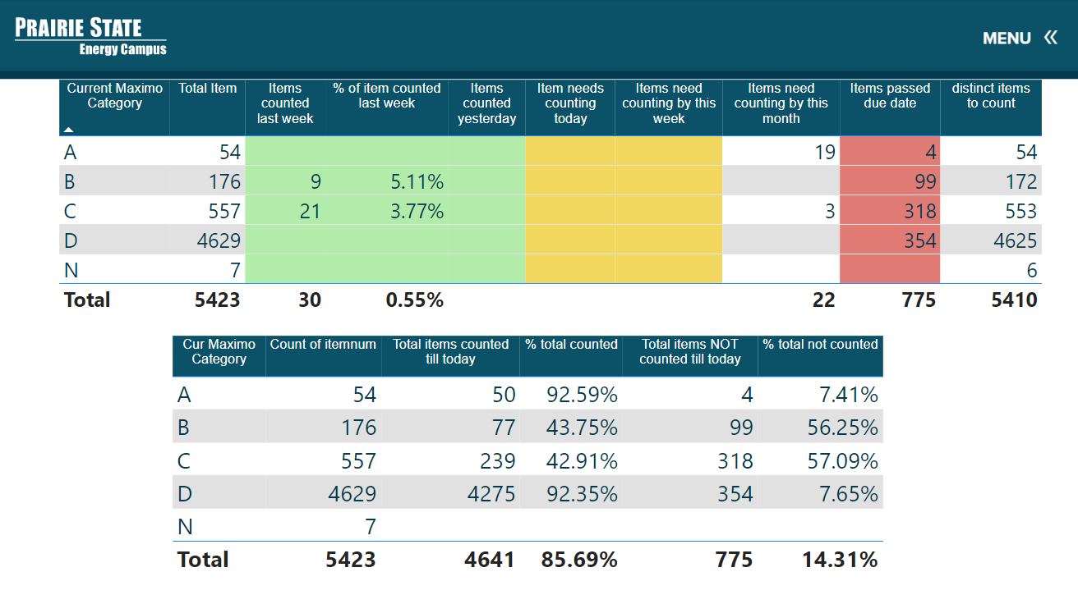
Item count Analysis of Mine Inventory
A Items – 90 days
B Items – 180 days
C Items – 270 days
D Items – 365 days

Slide 6
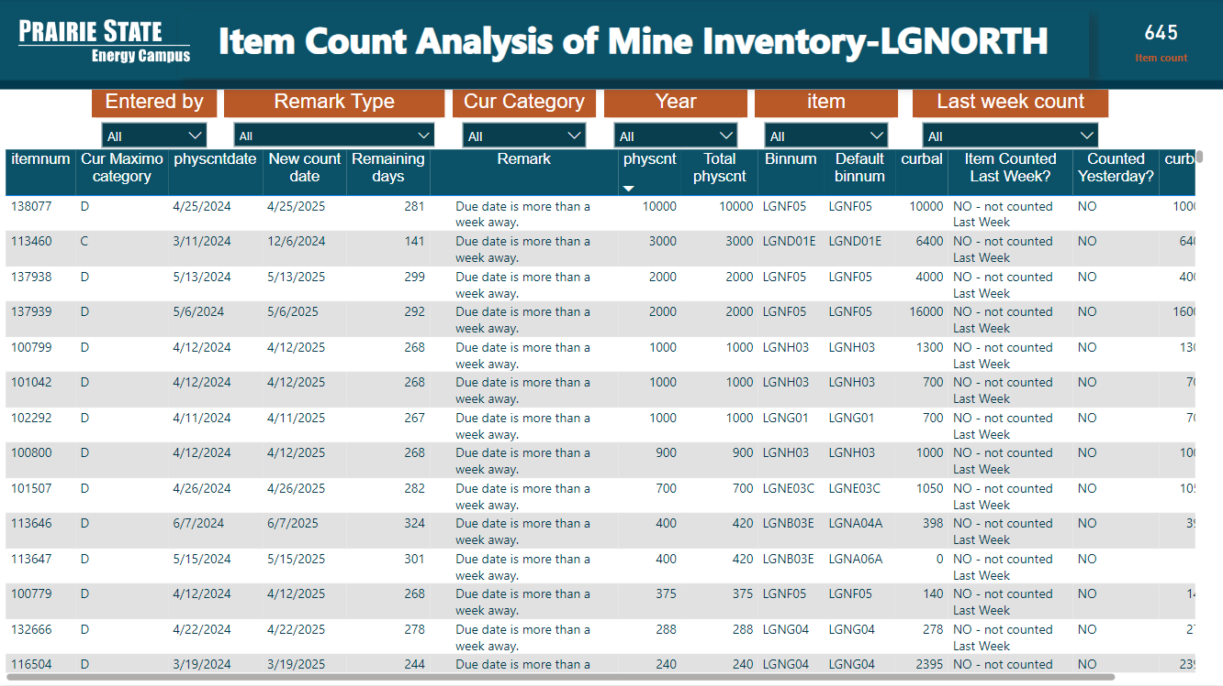
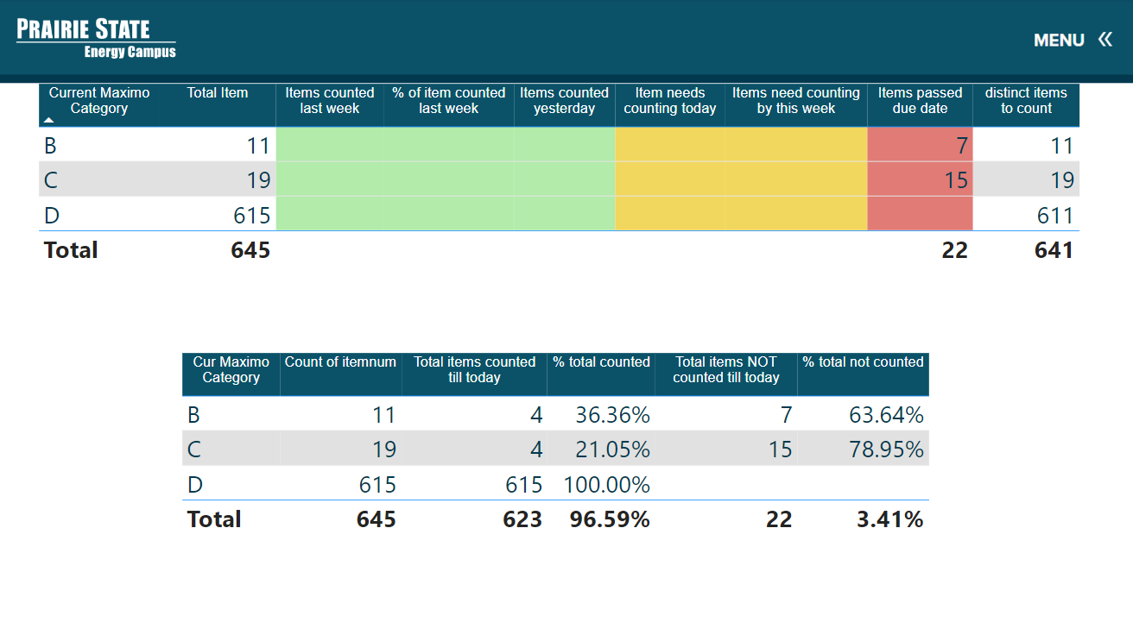
Item count Analysis of LGnorth Inventory
A Items – 90 days
B Items – 180 days
C Items – 270 days
D Items – 365 days

Slide 7
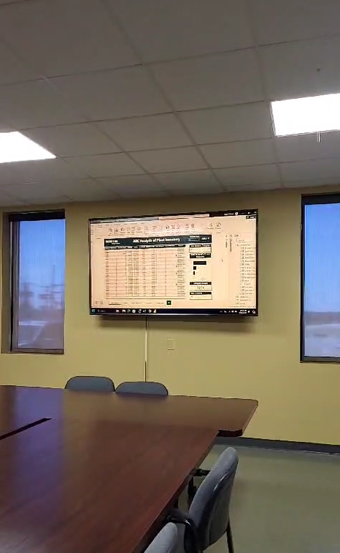

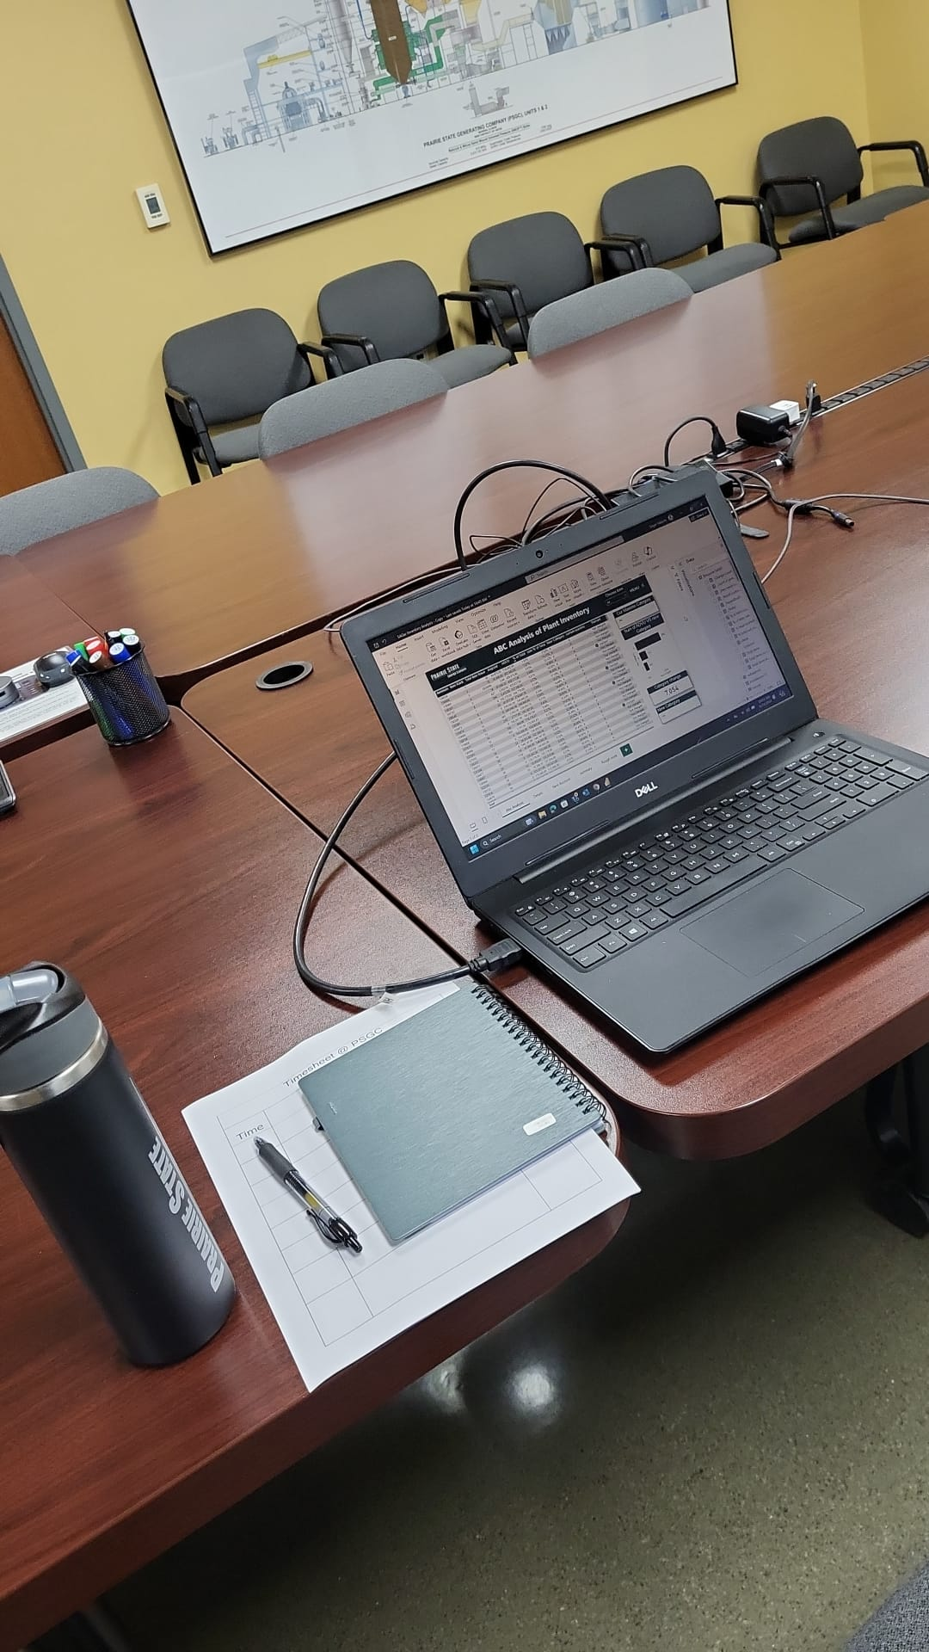
Presentation
Presentation to the stakeholder about their feedback.
Stakeholder feedback: Dashboard will make make work easier, more systematic, and efficient, eliminating manual effort.
Direct Interaction with Stakeholder, Implementing their needs, and learning how they will use the dashboard in their workplace
Experiencing something beyond university culture: Witnessing who will use the dashboard and how it will help in data driven decision making
Best part of the Internship: Witnessing how Act part of data analysis works
Notes:
Experiencing something beyond university culture: Witnessing firsthand who uses the project/dashboard and how it informs decision-making

Slide 8

Special Thanks To:
Josh Hagene, Mackenzie Tabing, Jonathan Sander, Jeff Miller, Tom Foust Jr
Tyler Tiemann, Claire Beyes, Alyssa Lohmann
David Sohn, Dustin Wethen, Justin Gale
Randy Short and whole PSGC teams.

Slide 9


